Slide 1
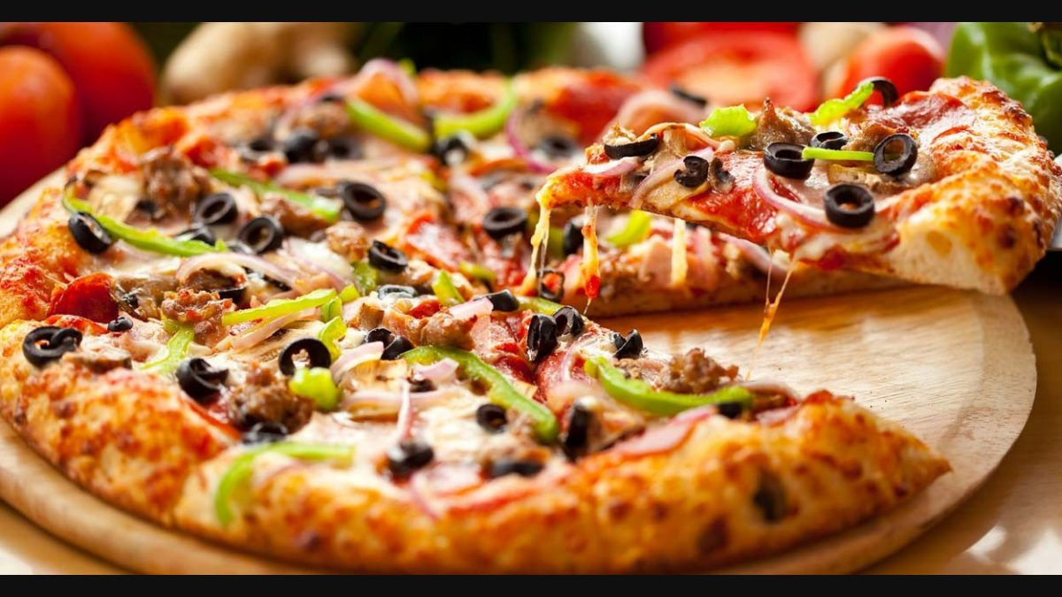
PIZZA SALES
REPORT - 2015
BY
Neel Balar
10th July, 2023

Slide 2
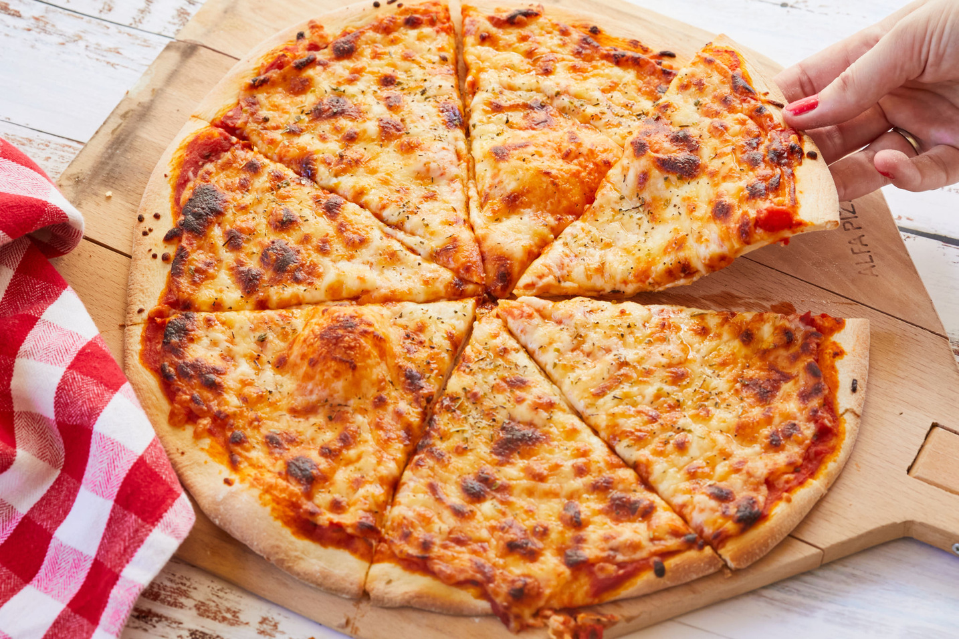
OVERVIEW
The pizza place aims to leverage its business strategy by understanding more about its customers preferences, peak hours, busiest days, best-selling pizzas, understanding the seasonality in the sales, least selling pizza, improving their staff management and building strategies to increase their revenue.
"You can't buy happiness. But you can buy pizza, and that's kind of the same thing."

Slide 3


METHODOLOGY
Understand the data.
Clean the data.
Organize the data
Data analysis.
Conclusion.

Slide 4

GOALS
Identify Customer Preferences
Optimize Menu and Pricing Strategies
Identify Peak Sales Periods
Forecasting and Planning

Slide 5

KPIs
Number of customers each day
Number of orders in queue at a given time
Peak hours
Top bestselling pizza
Revenue generated in a year
Seasonality in sale
Least selling pizza

Slide 6

SUM, AVERAGE, MULTIPLICATION, ROUND, COUNT, Month, Hour formulas
VLOOKUP, formatting, Sorting.
Pivot Tables
Charts
Concepts Used

Slide 7

ANALYSIS
“The core advantage of data is that it tells you something about the world that you didn’t know before.”

Slide 8
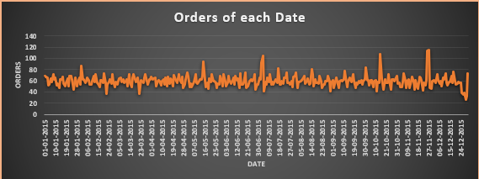
How many customers do we have each day?
Average customers per day: 60
Highest customers on a day: 26/11 and 27/11

Slide 9
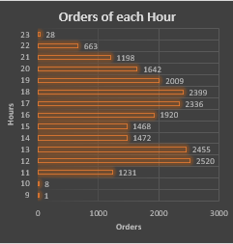
Are there any peak hours?
Peak Hours: 12 pm to 2 pm and 5 pm to 7 pm

Slide 10
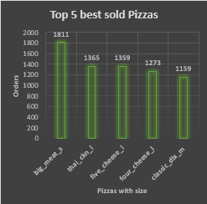
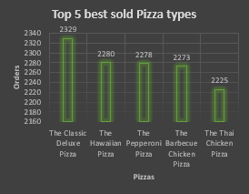
How many pizzas are typically in an order?
Average Pizzas per order: 3
Do we have any bestsellers?
Best seller Pizza: big_meat_s
Best seller Pizza type: The Classic Deluxe Pizza

Slide 11
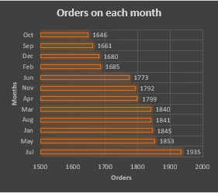
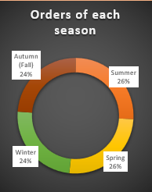
How much money did we make this year?
Total Revenue: $ 817860
Can we identify any seasonality in the sales?
Most Sale in a particular month: July
Most Sale in a particular season: Summer & Spring

Slide 12
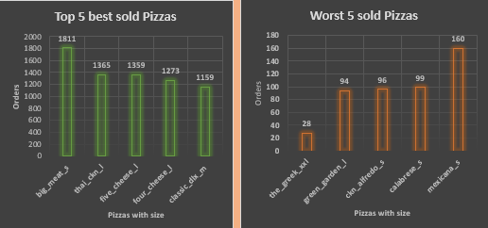
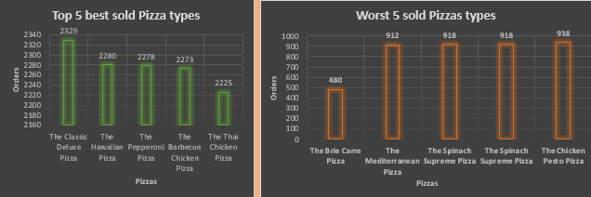
Are there any pizzas we should take off the menu, or any promotions we could leverage?
Worst sold Pizza: the_greek_xxl
Most sold Pizza: big_meat_s
Worst sold Pizza type: The Brie Carre Pizza
Best sold Pizza types: The Classic Deluxe Pizza, The Hawaiian Pizza, The Pepperoni Pizza, The Barbecue Chicken Pizza, The Thai Chicken Pizza
So we should take off these least sold pizzas.
And we can give some discount and some offers or more promotions on best seller pizzas in order to generate more revenue and increase more customers.

Slide 13

CONCLUSION
The dataset provides a thorough overview of the sales and ordering trends for pizza, which may be utilized to develop insights and make sensible decisions.
By leveraging the insights gained from the analysis of pizza sales data, we can make informed decisions, enhance customer satisfaction, and drive business growth in the highly competitive pizza market.

Slide 14

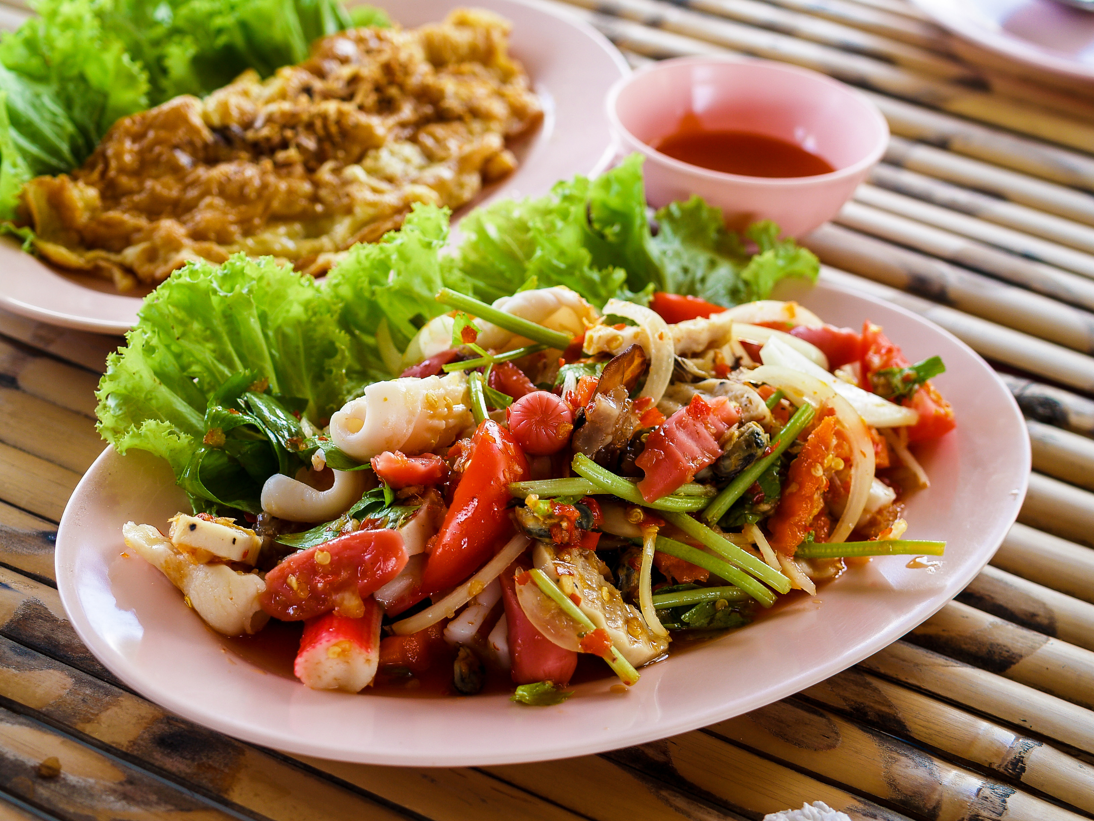
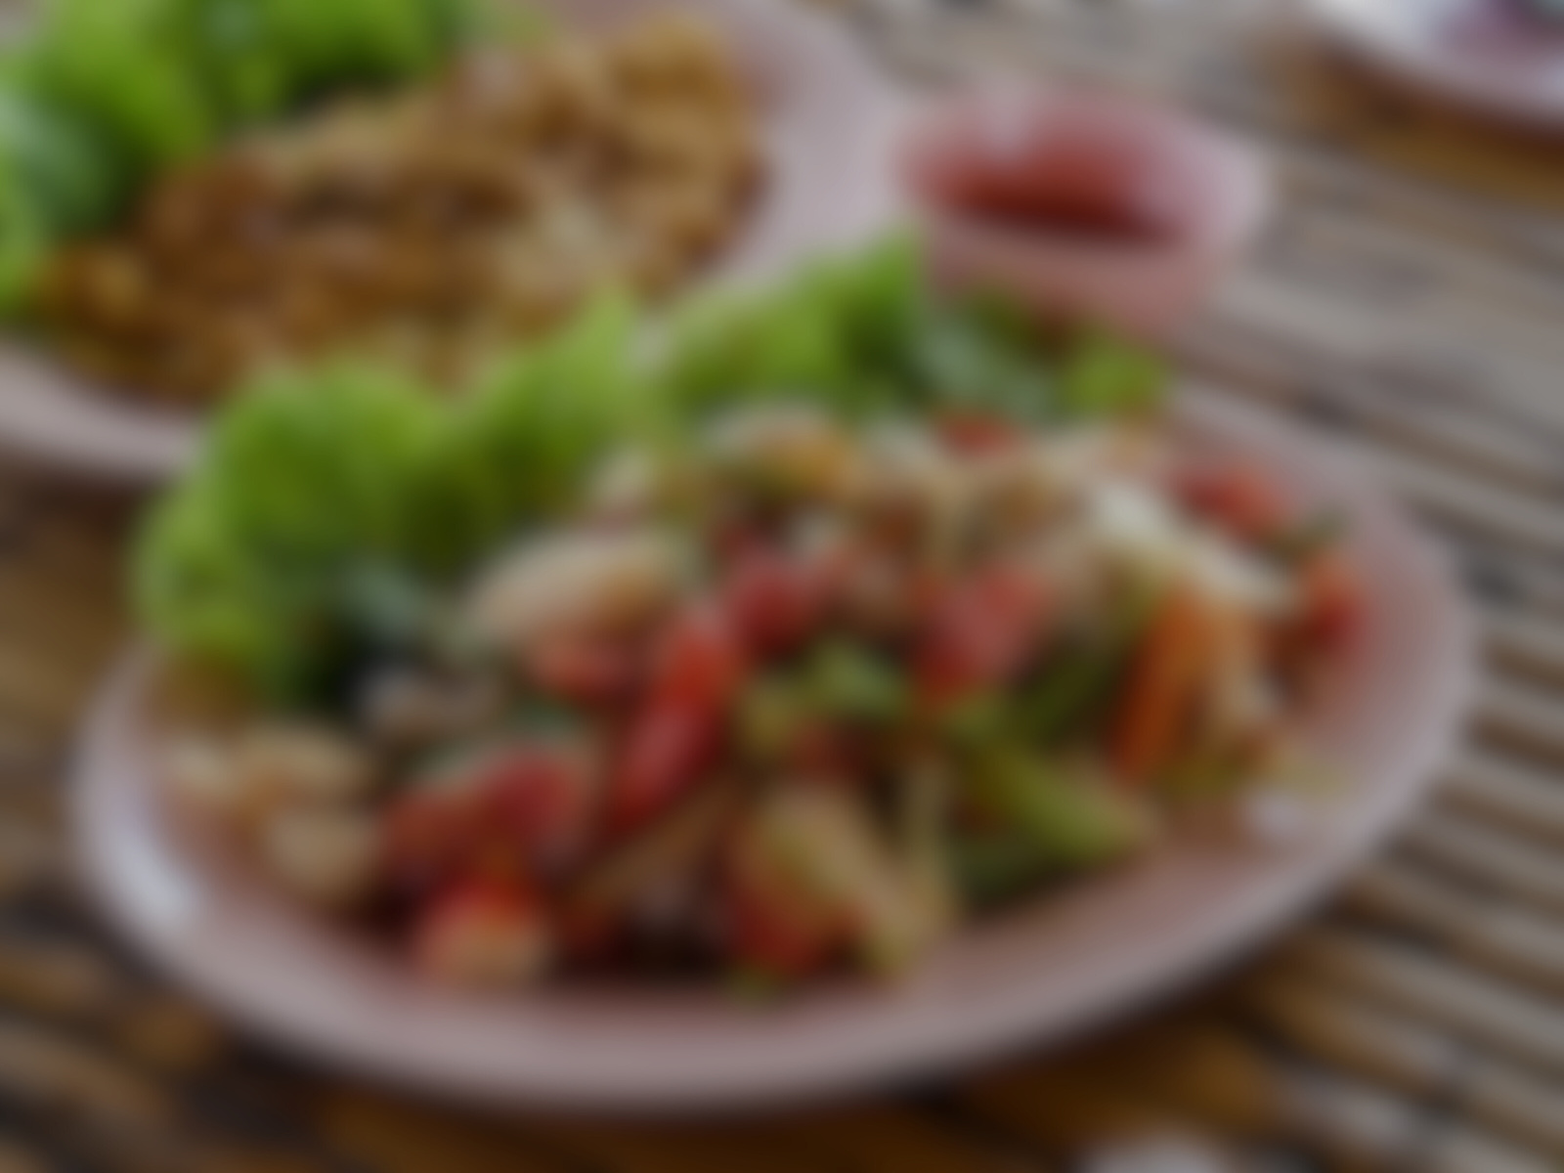
THANK YOU

